Slide 1
Meeting Week 18
Last week summary
Augmentation code
  Adapt to gantry case
Outline ToDo next week

Slide 2
Last week summary

Slide 3


Slide 4


Slide 5

Lagrange-Euler - Garcia

Slide 6

Lagrange-Euler - Garcia

Slide 7
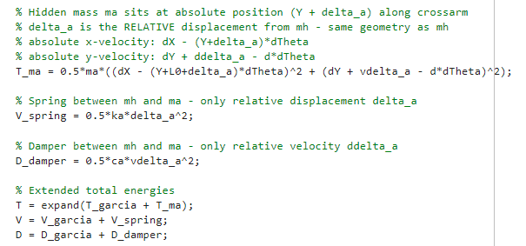
Lagrange-Euler – Additional state
Only added offset L0

Slide 8
Results verified against simscape
System with MSD vs Simscape with MSD
RMSE X1 : 2.4919e-07 m
RMSE X2 : 1.6463e-07 m
RMSE Y : 5.0275e-09 m
System without MSD vs Simscape with MSD
RMSE X1 : 4.4957e-07 m
RMSE X2 : 2.9607e-07 m
RMSE Y : 7.6171e-09 m
For ASMPT it was required that the formulas for the additional state are correct

Slide 9
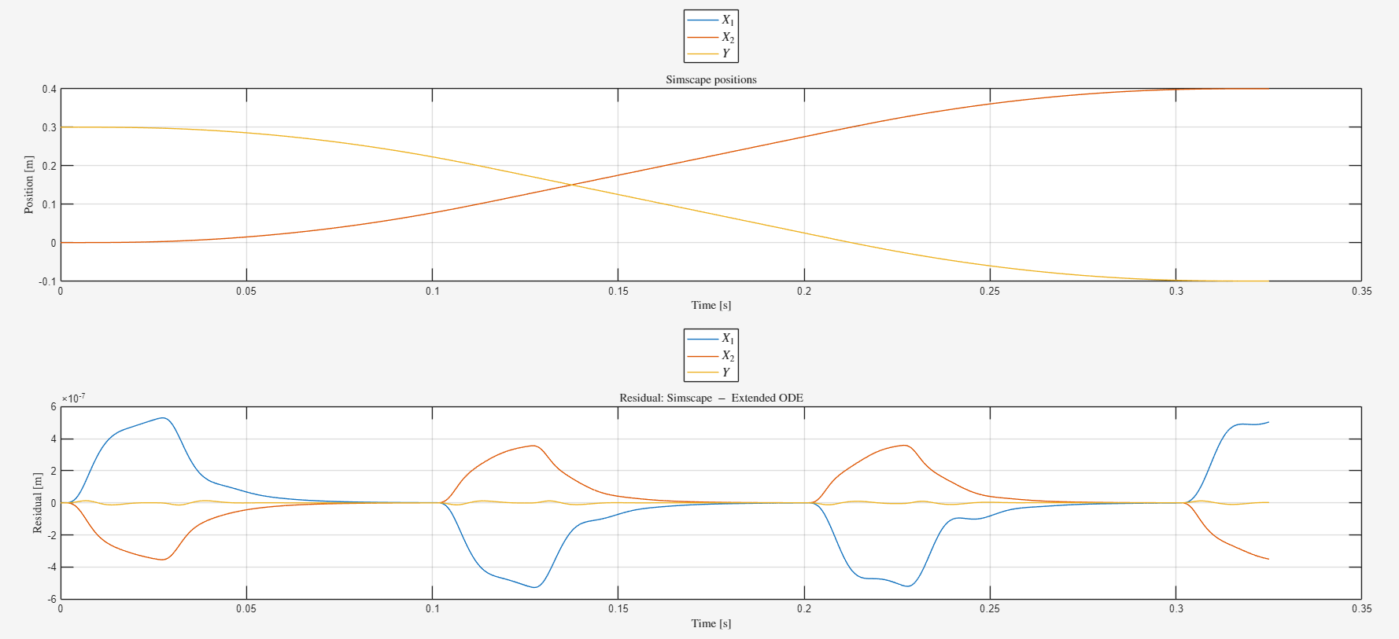

Slide 10
Additional state against simscape
Additional state delta_a (extended ODE vs Simscape)
RMSE delta_a : 2.1787e-10 m

Slide 11
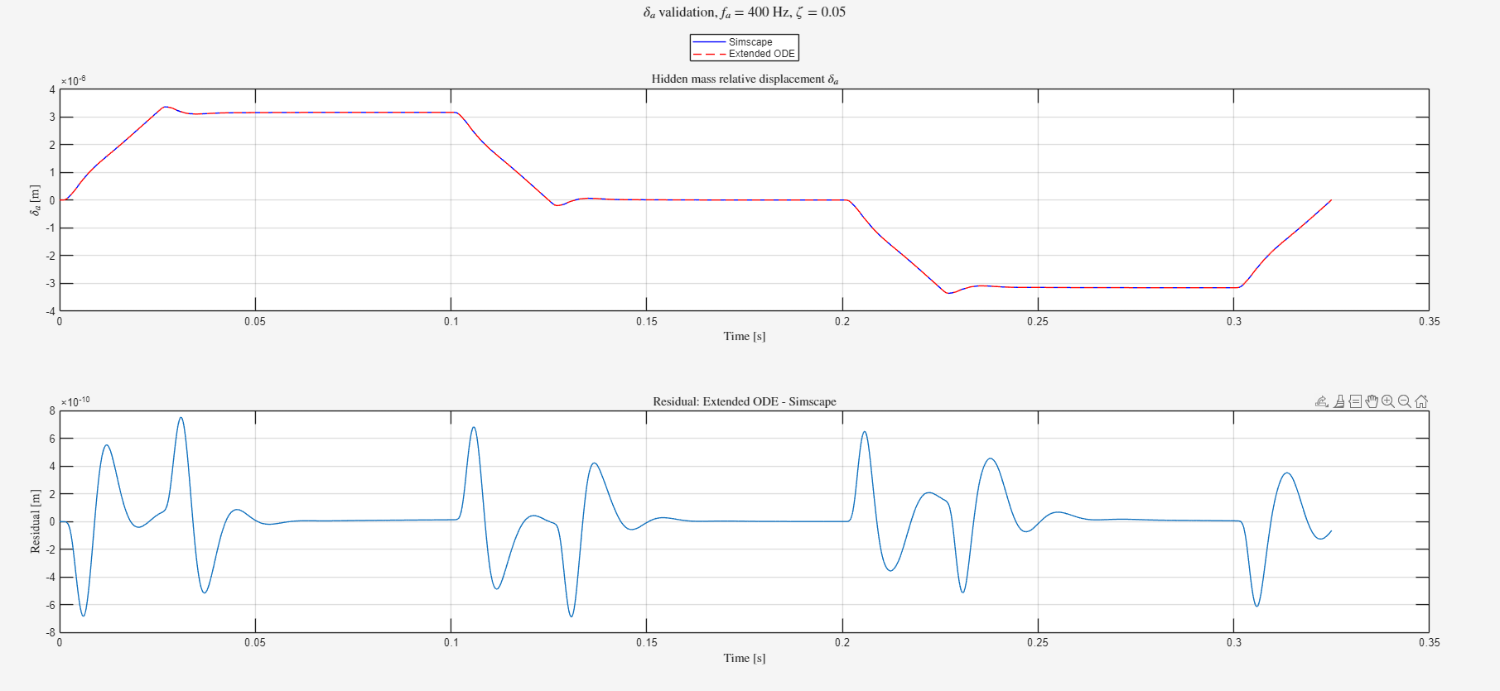

Slide 12
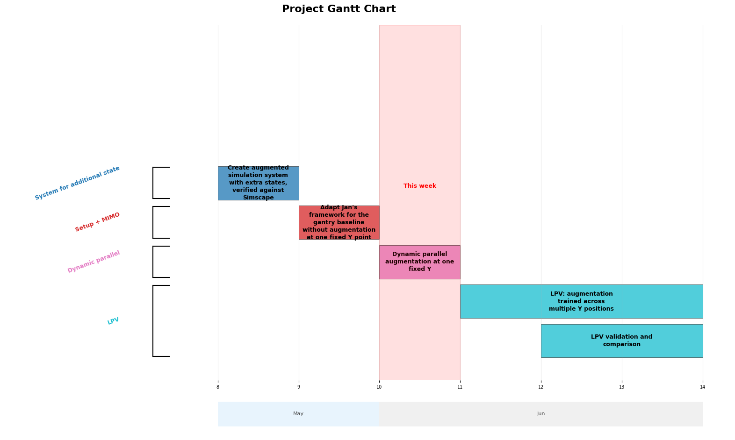

Slide 13
Currently one trajectory only
No LPV implementation kept at one Y-operating point
The MSD is attached to the Y-beam
  Will first have to implement LPV before augmentation (dynamic parallel) of the additional state

Slide 14
Encoder
Estimates where the gantry is and how fast it’s moving at the start of the trajectory
Compare:
  Encoder-init: simulation started from the encoder's estimated position/velocity
  Zero-state: simulation started from rest at the origin

Slide 15
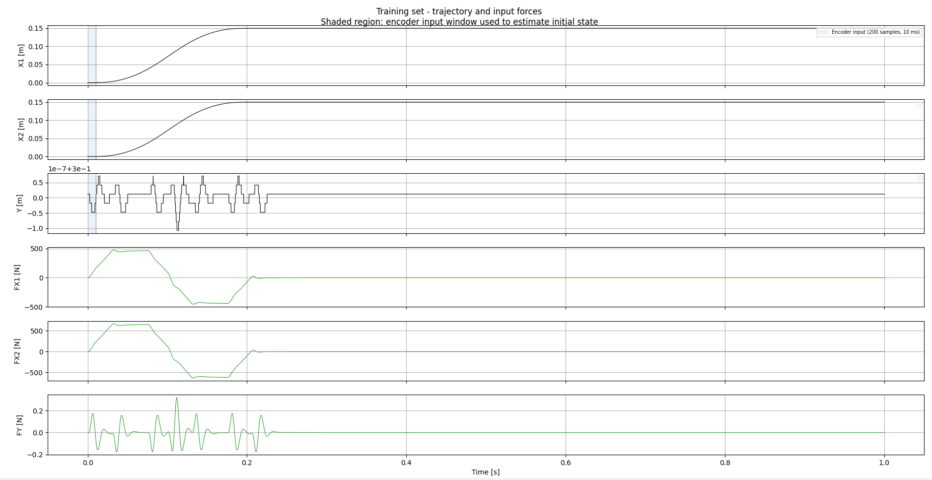

Slide 16
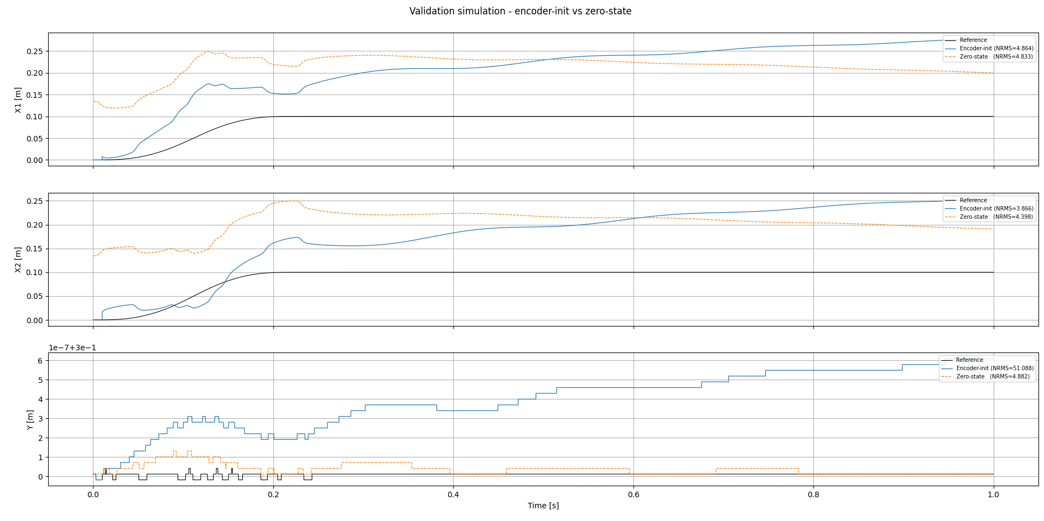

Slide 17
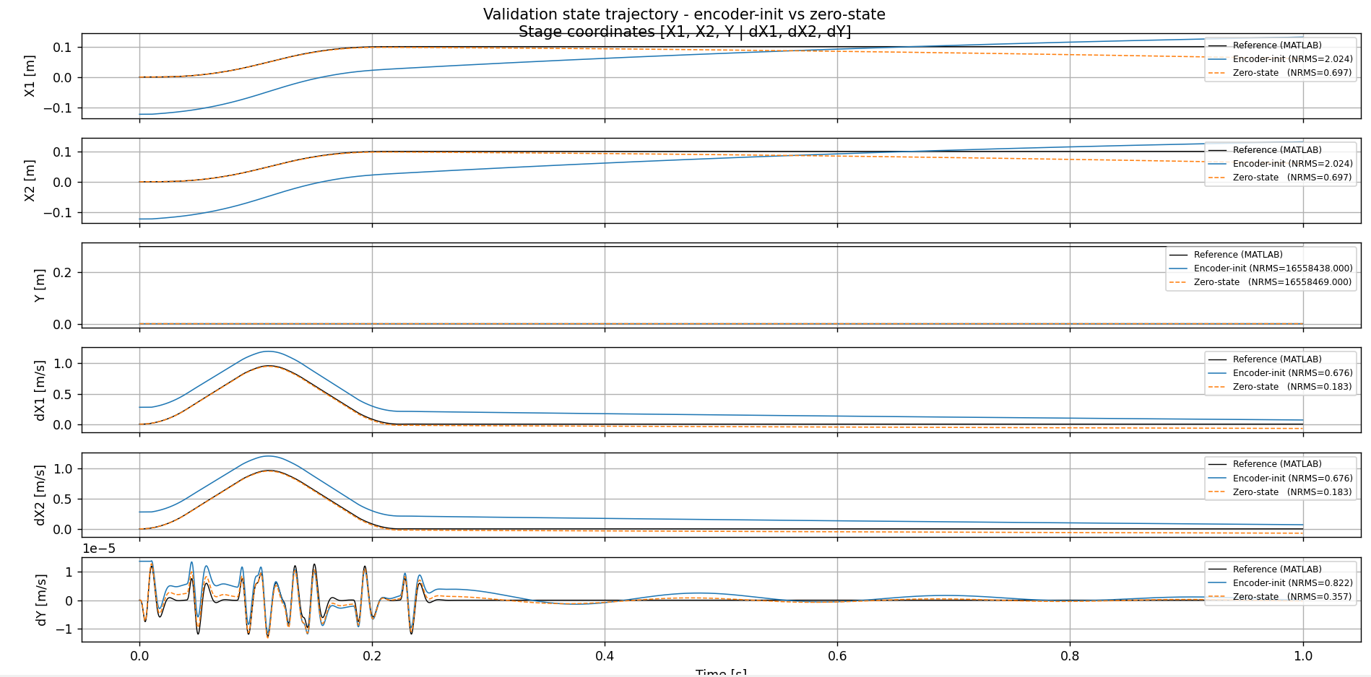

Slide 18
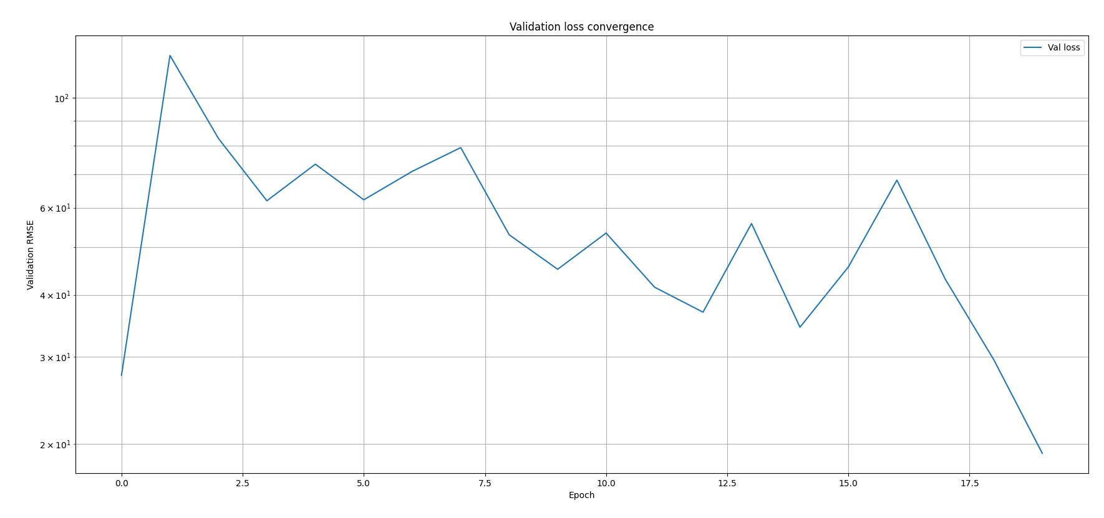
Ran for 50 epochs, but saved up till the best epoch

Slide 19
Encoder mimo data verification
What after… dynamic parallel…? Lpv? I need LPV to excite the MSD, so…

Slide 20
Frf voor sample length etc

Slide 21
- The FAIL is not a model failure. The encoder slightly
miscalibrates the Y initial condition, which has negligible
physical effect (~microns), but dividing by near-zero std makes
it look catastrophic
For Phase 1, report X1 and X2 only, and explicitly note that Y
is excluded because it is frozen (zero variance, NRMS is not a
meaningful metric). The actual research result is:

Slide 22
gantry_subnet_verification.py
------------------------------
Verify that the full SSE_Interconnect pipeline (encoder + Gantry_State_Block +
Linear_Output_Block) trains correctly on matched MATLAB data (Phase 1).

Slide 23
RK4 implementation of continuous model
1. Gantry_State_Block — the core contribution. A
physics block for the 3-DOF gantry with
LFR-structured RK4 integration.

Slide 24
Currently one trajectory Y does not move no lpv model treated as LTI (one Y-operating point)

Slide 25
Show plots encoder
What does the encoder do; explain
Plot of validation? Plot of trajectory + input forces

Slide 26
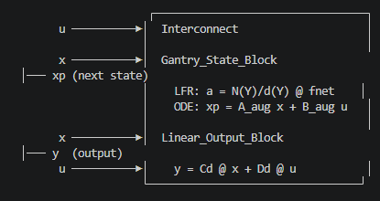
The wiring calls (connect_signals,
connect_block_signals) tell the Interconnect which named
signals to feed into each block's inputs. At runtime,
interconnect(x, u) executes all blocks in order and
returns (y, x_next).
SSE_Interconnect wraps this: it adds an encoder network
on top. During training, the encoder maps (u_past,
y_past) → x̂₀, then the interconnect rolls forward for NF
steps. The loss is the BPTT error over those steps.

Slide 27
Lists problems to be careful for, for LPV
Jacobian
…
State estimation..?

Slide 28
Question 1
If a question needs to be answered. Make clear here what the problem/question is that needs to be answered. Questions can always be asked outside the meeting, but we may say prepare to explain what you really mean.
Some figure explaining the concept
When applicable, the same as will go in final report. Otherwise just take screenshots from relevant papers.

Slide 29
Should I add the velocities as states?
Encoder becomes better because…
Does the system save these?

Slide 30
Outline next week
Update planning
  Complete planning
  If possible add gantry experiments
Encoder
LPV
Verify that with the real physical angle constraints we can still recover the parameters

Slide 32
Float64 compared against float32
but I save matlab files as float32

Slide 33
Kijken Kleine hoek parameter recovery

Slide 34
Cpu vs gpu

Slide 35
Kijken of ik een script heb voor LPV verifiëren door hele interconnect etc.

Slide 36
Augmentation difference static and parallel
Know x_tilde

Slide 37
The encoder exists because of how the training works:
The core problem: Jan's framework trains via multi-step rollout (BPTT). To roll out y_hat,
x_next = hfn(x, u) for nf steps, you need an initial state x0. But you never measure the full
state directly, you only have input/output measurements (u, y).
Why you can't just use the analytical baseline during training:
1. Velocities from finite differences are noisy and only approximate the true state
2. ANN states have no physical meaning, so there's no analytical way to set them. Zero is just
a guess.
3. Most importantly: x0 needs to be differentiable with respect to the network parameters. A
fixed analytical x0 is a constant, so gradients from the rollout loss can't improve the
initialization. The encoder is a neural network, so it's part of the computation graph and
gradients flow through it.
In short: the encoder solves the state reconstruction problem, mapping (u_past, y_past) → x0,
in a way that is:
- Learned from data (adapts to the actual system)
- Differentiable (enables end-to-end BPTT training)
- Complete (estimates both physical states and ANN latent states)
Without it, every rollout window would start from a suboptimal, non-differentiable guess, and
the ANN augmentation states would always start at zero. The encoder lets the model "warm up"
its internal state from measurement history before predicting forward.
Benefit encoder

Slide 38
Good question. The encoder doesn't get evaluated on how well it
estimates x0 directly. There's no ground truth for x0 to
compare against (especially not for the ANN states).
Instead, the evaluation is indirect, via rollout quality:
1. Encoder produces x0 from the past I/O window
2. We roll forward from that x0 for nf=350 steps using hfn(x,
u) with the actual future inputs
3. The rolled-out output y_hat (positions X1, X2, Y) is
compared against the measured output y_ref
4. RMS = sqrt(mean((y_hat - y_ref)^2))
So the RMS is purely on the output prediction error over the
rollout horizon, not on the state estimate itself. A good x0
produces a rollout that tracks the measured output well; a bad
x0 causes the rollout to drift.
This is why the analytical baseline comparison is meaningful:
if you initialize with (measured positions, finite-diff
velocities, ANN=0) and roll forward, you get some output error.
If the encoder's x0 produces a rollout with less output error,
the encoder is doing something useful, likely estimating
better velocities and/or non-zero ANN states that improve the
prediction.
You never directly compare encoder states to "true" states
because there is no ground truth state, only ground truth
outputs.

Slide 40
What is the encoder?
neural network that maps past I/O history (u_past, y_past) to an initial state x0
x0 contains both physical states (positions, velocities) and
ANN augmentation states

Slide 41
Why do we need it?
BPTT training rolls out the model for i-amount of steps from an initial state x0, but we only measure outputs (positions), not the full state
Analytical alternative (positions from measurements, velocities from finite differences, ANN states = 0) is not differentiable, so gradients cannot improve x0 during training
ANN augmentation states have no physical meaning, only the
encoder can learn to set them

Slide 42
How do we evaluate it?
Data from system with added MSD
There is no ground truth state to compare x0 against
Instead, we evaluate indirectly: roll forward i steps from x0 through the full augmented model and compare predicted output y_hat against measured output y_ref over the rollout horizon
Compare encoder-initialized rollouts against analytical baseline rollouts (same trained model, different x0)

Slide 43
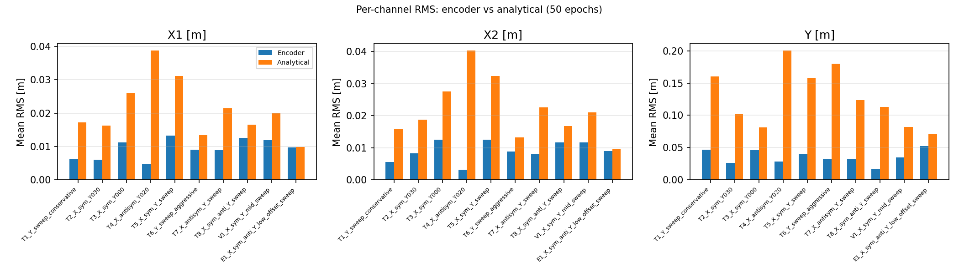
Notes:
For each trajectory, for each output channel (X1, X2, Y): the mean RMS error across all rollout
windows in that trajectory, comparing encoder-init vs analytical-init.
Concretely, for one bar:
1. Take all windows in that trajectory (up to 10, evenly spaced)
2. For each window, compute per-channel RMS: sqrt(mean((y_hat[:, ch] - y_ref[:, ch])^2)) over
the nf=350 rollout steps
3. Average those per-window RMS values across windows
So each bar = average rollout prediction error on one channel of one trajectory, over 350 steps
(0.35s at 1kHz).

